Slide 1
Problem Statement Title: Personalized Product Recommendations
Team Name: Console.log

Slide 2

Team members details
Team Name | console_log
Institute Name/Names | Indian Institute of Technology, Guwahati
Team Members > | 1 (Leader) | 2 | 3
Name | Mohit Manoj | Akanksha Gupta | Nidhi Shrivastava
Batch | 2024 | 2024 | 2024

Slide 3
Deliverables/Expectations for Level 2 (Idea + Code Submission)
Please follow guidelines as mentioned in the problem statement Doc.

Slide 4
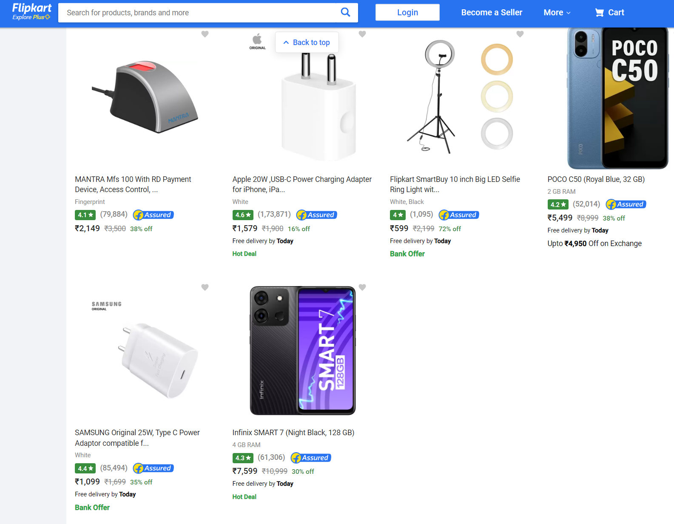
Use-Cases
Priority 1
Personalized Product Recommendations
The products under each category will be ranked according to items in the user’s wish-list, search history and purchase history using user similarity. It looks for users with similar preferences, interests, and purchase histories.
Scenario
Mark, a software developer, loves to purchase latest gadgets. Based on the user similarity algorithm, the platform suggests him tech products based on other users with similar preferences. This helps hem discover good relevant products. He is impressed with these product recommendations as they are quite accurate and tailored to his specific tech interests.
Value Proposition
Implementing a user similarity-based product recommendation system enhances the shopping experience. This will increase the relevance and conversion of products. The system encourages users to spend more time exploring the platform and making purchases.
The products in every category will be based on the history of users with similar preferences.

Slide 5
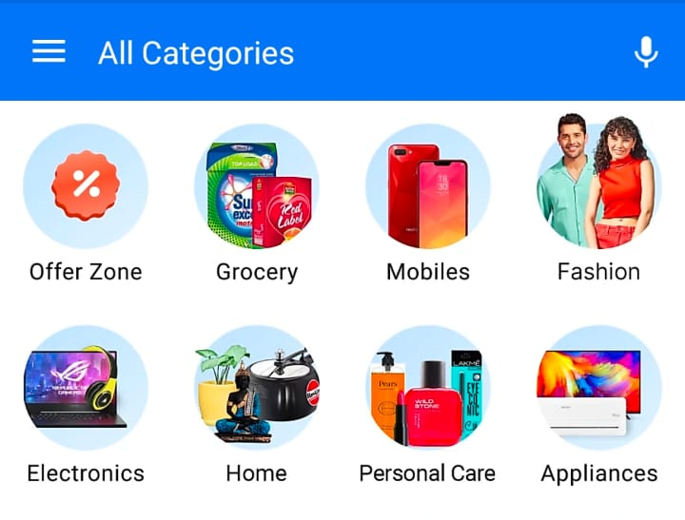
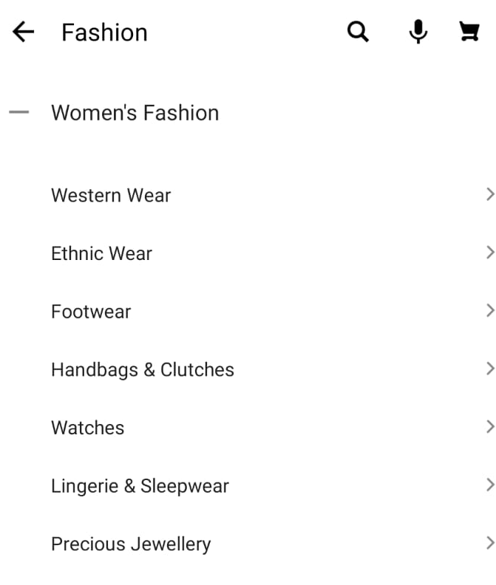
Use-Cases
Priority 2
Dynamic user-specific categories
As a user signs up on Flipkart, he/she is presented with categories based on the general popularity. After multiple sessions, the categories dynamically adapt to reflect the user preferences.
Scenario
Maria, a fashion enthusiast loves experimenting with Indian ethnic wear. When she logins into Flipkart, the fashion
category appears on top. When she expands this section, the ethnic wear column appears first, followed by accessories and so on. The categories ranking based on her preferences has made it easier for her to navigate through multiple options, making it easy for her to discover new items that align with her interests.
Value Proposition
The platform adapts to users' changing preferences over time, ensuring they always find relevant categories and sub-categories that pique their interest. This feature enhances user engagement, encourages exploration of new categories, and ultimately leads to increased customer satisfaction and loyalty on the platform.
These categories will be ranked on the basis of user preference and past interaction.

Slide 6
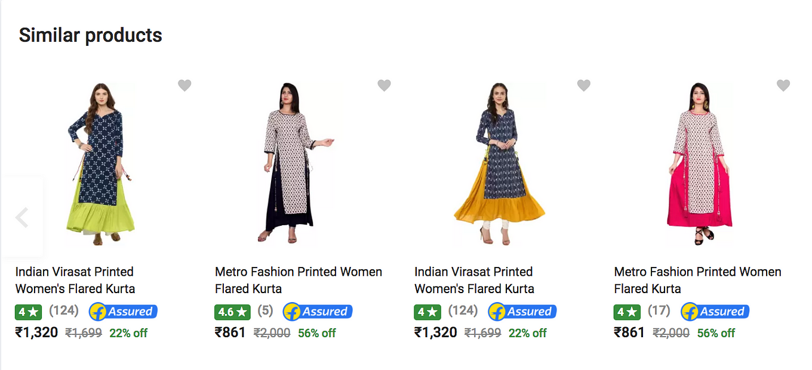
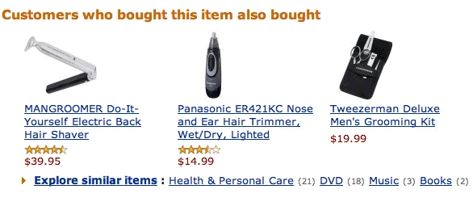
Use-Cases
Priority 3
These products will be ranked on the basis of highest similarity score.
Cross-selling and upselling
Upon choosing a product, the platform will recommend a series of similar products and a list of complementary products based on what other users who bought this product also bought.
Scenario
Rahul, a photographer, wants to purchase a new camera similar to his old one. He navigates to his previous camera purchase and finds similar cameras. The platform recommends him complementary items based on what other users bought. He realizes he will also need lenses and adds them to his cart. These recommendations assisted him to discover products he might need in addition to his original product.
Value Proposition
By suggesting complementary products, Flipkart can boost average order values as users add more items to their carts. Complementary recommendations promote cross-selling by showcasing products users might not have considered on their own.
This recommendation approach provides a comprehensive shopping experience that caters to users' needs, preferences, and potential use cases, leading to increased user satisfaction and improved business outcomes
These products will be ranked on the basis of maximum co-purchase frequency.

Slide 7
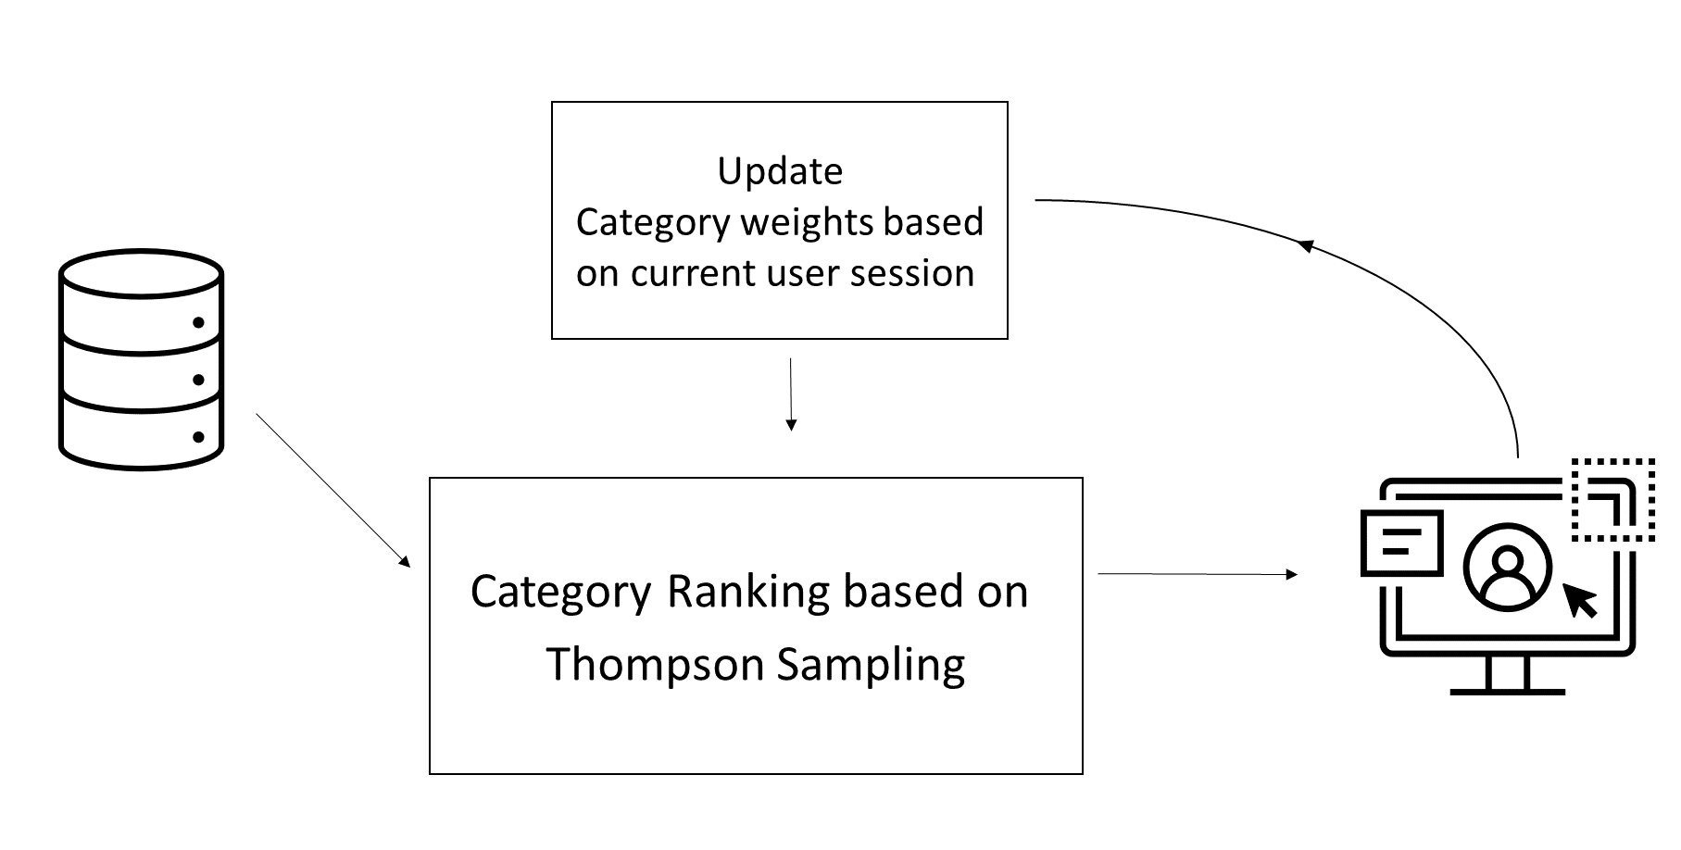
Proposed Approach
Dynamic user-specific categories
Category generation using Reinforcement Learning
Input: Sequence of categories
Thompson Sampling:
Initialization: The algorithm starts with a prior belief or probability distribution about the true rewards associated with each arm. This probability is calculated using the general category trends.
Exploration and Exploitation: The algo randomly samples from each arm's probability distribution at every iteration. The arm with the highest sampled value is chosen, striking a balance between exploring potentially rewarding arms and exploiting arms with a proven track record.
Feedback and Update: Once an arm (here, category) is chosen and its reward(user interaction) is seen, the algorithm adjusts the associated probability distribution. This update uses the new information to fine-tune the distribution. Successful arms shift towards higher rewards, while underperforming arms shift towards lower rewards.
Repeat: The cycle of picking an arm, observing rewards, and updating distributions repeats. With more data, the algorithm gains confidence in identifying arms likely to yield higher rewards.
Output: Ranked list of categories based on probabilities

Slide 8
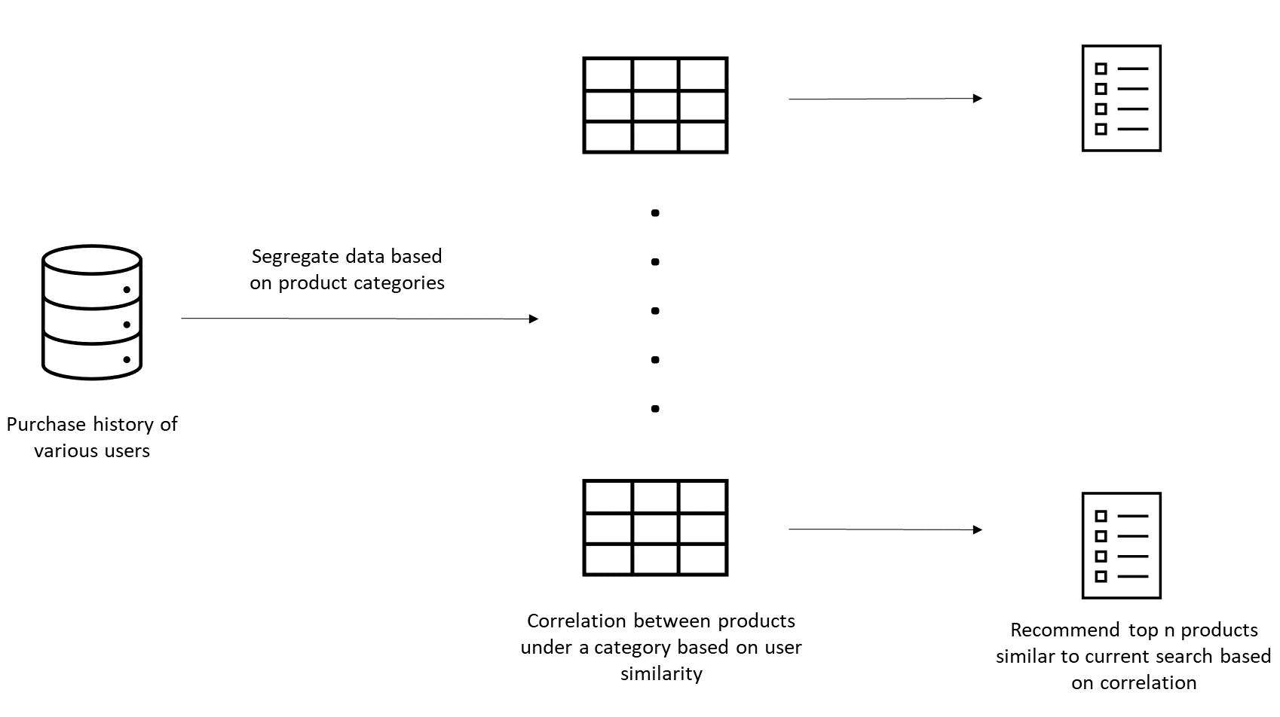
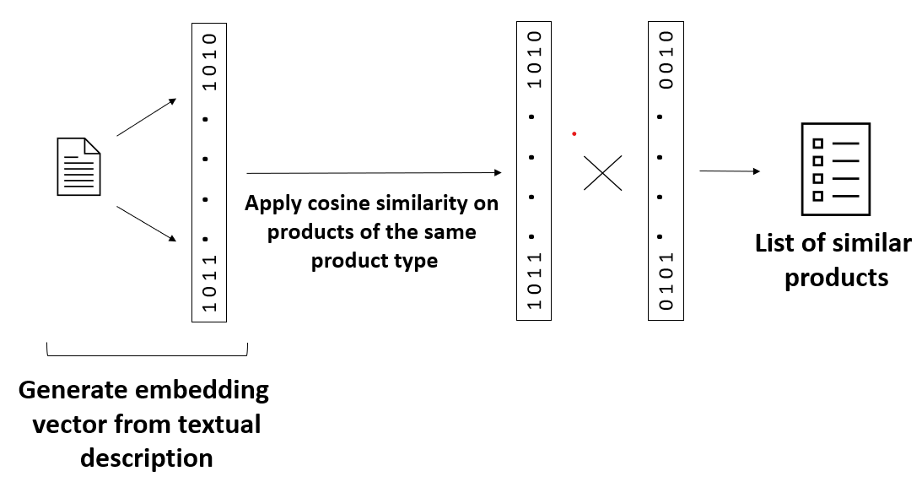
Proposed Approach
User-similarity + Product similarity
Product Recommendation using Collaborative Filtering
Input: Category, User search and purchase history, Product description tags
User-Item collaborative filtering: Recommendations are generated by identifying users with similar preferences and interactions, suggesting items liked by those users.
Item-Item collaborative filtering: This approach focuses on the relationships between items rather than users. Similarity is calculated using product tags.
Interaction matrix: Create a matrix where rows represent users and columns represent items. The matrix is filled with interactions, here purchases. For item similarity, the tags are encoded and represent the columns.
Finding Similarities: For user-based collaborative filtering, similarities between users are computed based on their interactions with items. Similarly, for item-based collaborative filtering, similarities between items are computed based on matching tags.
Generating recommendations: After computing similarities, the algorithm finds the most similar users or items to the target. For user-based filtering, it recommends items liked by similar users. For item-based filtering, it suggests similar items.
Output: Ranked list of products for each category, Similar products

Slide 9
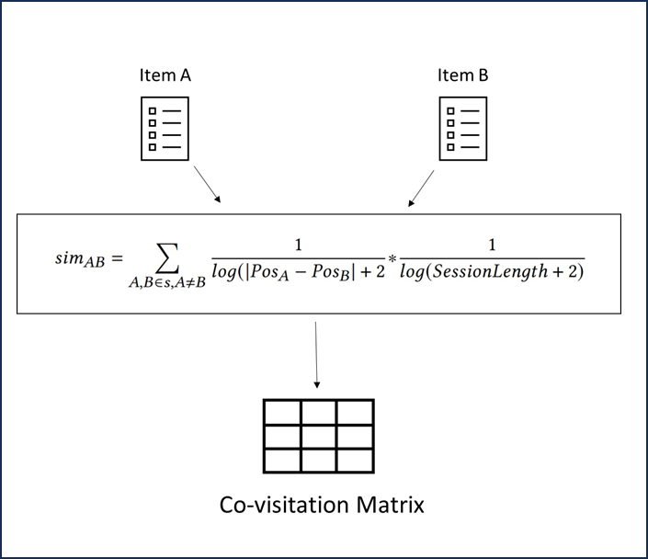
Proposed Approach
Customers who bought this also bought
Products recommendation using co-visitation matrix
Input: Product sequence
Co-visitation Matrix:
From each session history, we consider every combination of two items (from their complete list of history items). These are pairs of items. Each pair implies that when a user interacts with Item A then they are likely to also interact with Item B. By using all session’s histories we count up every occurrence of each pair of items and we keep the most frequent ones.
We weight the pairs depending on the position differences in the sequence and the total length of the session.
Output: Ranked list of complementary products

Slide 10
Evaluation Metrics
Click-Through Rate (CTR): Measures the ratio of clicks on recommended items to the total number of recommendations.
Conversion Rate: Measures the percentage of users who make a purchase after receiving recommendations.
Average Order Value (AOV): Measures the increase in average order value.
User Feedback and Surveys: Collect user feedback through surveys, ratings, and reviews to understand user satisfaction and perception of recommendation quality.
A/B Testing and Split Testing: Conduct controlled experiments where users are randomly assigned to different recommendation algorithms or strategies. This allows you to compare the performance of different approaches in a real-world setting.

Slide 11
Strengths
Limitations
Learning from Interaction: Reinforcement Learning learns through trial and error by interacting with an environment, enabling agents to adapt and improve their behavior over time.
User-Centric Recommendations: Collaborative Filtering focuses on user behavior and preferences, offering personalized recommendations based on the behaviors and choices of similar users.
Flexibility Across Domains: Our model is versatile and can be applied to a wide range of domains.
Sequential Decision-Making: RL excels in tasks involving sequences of decisions. It's capable of optimizing long-term strategies, considering the cumulative impact of decisions.
Limited data: Machine learning models, including collaborative filtering and content-based methods, require sufficient data to learn patterns and relationships. Limited data may lead to overfitting, where models learn noise rather than meaningful patterns.
Computational load: As the user and item base grows, the computation and storage requirements for collaborative filtering can become resource-intensive.
Cold Start Problem: Our recommendation algorithms can struggle with the cold start problem, particularly when dealing with new users or items that have limited historical data. Without sufficient data, the algorithm may not be able to make accurate recommendations.
Gray Sheep and Black Sheep Problem: Some users may exhibit preferences that deviate significantly from the norm, making them challenging to accurately recommend to using collaborative filtering methods.

Slide 12
Future Scope
Algorithm
Extending Use Cases
Using Deep Learning algorithms on image data: Image-based recommendations can suggest visually similar products based on shared visual features. Users who like a certain style of clothing or product can be recommended items with similar visual attributes.
Graph Neural Networks (GNNs) revolutionize e-commerce recommendation systems by leveraging interconnected user-product networks. GNNs capture intricate relationships, enhancing personalization, cross-domain suggestions, and mitigating cold start challenges.
Trending near you: Using user demography to find the trending products in a region. Highlighting trending and popular products among other customers will create a sense of urgency and encourage exploration of new items.
Personalized Deals and Discounts: Offering exclusive discounts or deals on products that align with the customer's preferences and purchase history, creating a sense of personal value.
Seasonal and Occasion-Based Recommendations: Recommending products suitable for specific seasons, holidays, or occasions (e.g., back-to-school, Valentine's Day), enhancing the relevance of our suggestions.

Slide 13
Thank You

